Slide 1
Hospitality Revenue Management, Guest Experience & Hotel Operations Analytics Platform
HOSPITALITY ANALYTICS | PROJECT 6
End-to-end data engineering and business intelligence solution
PRESENTED BY
Samruddhi Laxman Yeole
Jarvis Jerson
Ritesh Bansilal Kadam
Gunda Harshavardhini
M.H. Manu

Slide 2
Agenda
OVERVIEW
Hospitality Revenue Management, Guest Experience & Hotel Operations Analytics Platform
01
Context & objectives
Business challenge, project response and scope
02
Platform architecture
End-to-end flow and target platform layers
03
Ingestion & data quality
Source data, IDMC profiling and mappings
04
Data modelling
Medallion layers, SCD Type 2 and star schema
05
Analytics & insights
Streamlit results and dashboard findings
06
Security & access
Role-based access, secure views and masking
07
Validation & delivery
Testing, demo flow and five-day plan
08
Roadmap
Cortex AI, design decisions and next steps

Slide 3
From scattered hospitality data to centralized BI
PROJECT OVERVIEW
1
2
3
The platform
The technology
The outcome
An end-to-end hospitality analytics platform integrating guest, hotel, room, reservation, billing, feedback and booking-event data.
AWS S3 manages source files, Informatica IDMC handles integration and quality processing, and Snowflake provides centralized storage and analytical modelling.
Data flows through Bronze, Silver and Gold layers, enabling historical tracking, business reporting and advanced analytics via Snowpark Python, Snowflake Cortex and Streamlit.
DATA DOMAINS INTEGRATED
Guests
Hotels
Rooms
Reservations
Billing
Feedback
Booking events

Slide 4
Business challenge and project response
CONTEXT
Business challenge
Hospitality data is distributed across multiple source files.
Inconsistent formats and missing values affect data reliability.
Duplicate and invalid records can impact business reporting.
Historical reservation changes are difficult to track.
Management lacks a consolidated view of revenue and guest experience.
Project response
Technology foundation
Build a centralized, quality-controlled, scalable analytics solution that converts operational hospitality data into business-ready insights.
AWS S3 – source files and exception routing
Informatica IDMC – profiling, cleansing and validation
Snowflake – Bronze, Silver and Gold layers
Snowpark Python and Cortex – advanced analytics
Streamlit – interactive business dashboards
Outcomes
Centralized
One governed platform for all hospitality sources
Quality-controlled
Profiling, validation and exception routing
Scalable
Layered model with incremental processing

Slide 5
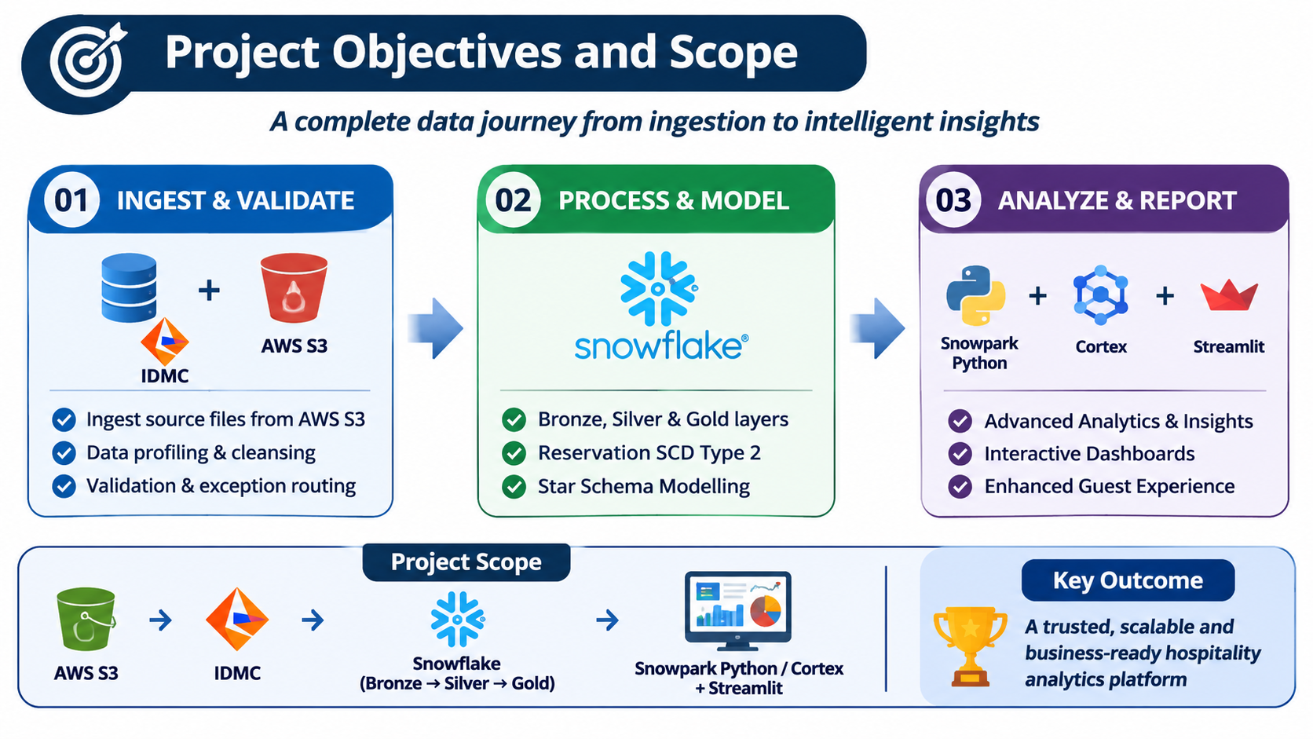
Project objectives and scope
CONTEXT

Slide 6
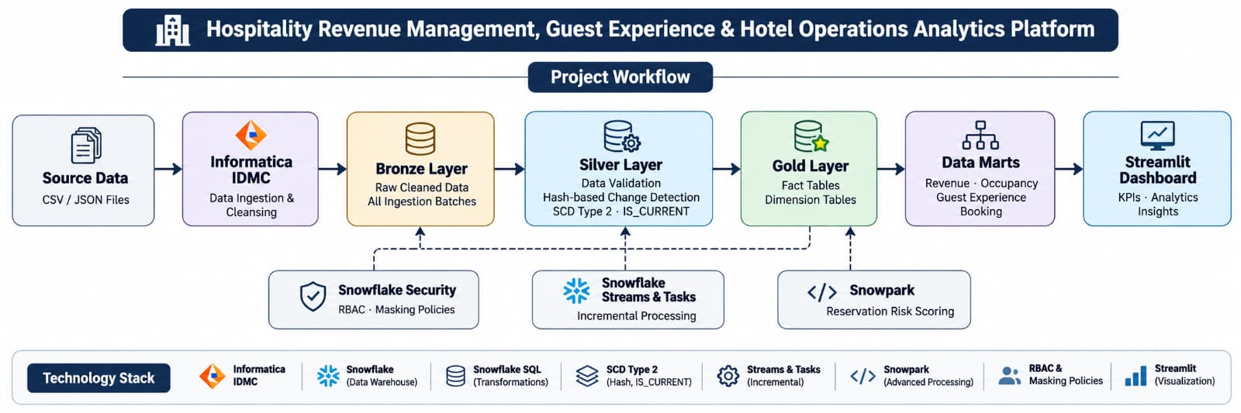
End-to-end architecture
ARCHITECTURE
Source files flow from AWS S3 through Informatica IDMC into Snowflake layers and on to Streamlit dashboards.
Flow: CSV / JSON files → IDMC cleansing → Bronze → Silver (SCD Type 2) → Gold → Data marts → Streamlit

Slide 7
Target platform architecture
ARCHITECTURE
A layered Snowflake warehouse supported by data-quality, security and incremental-processing controls.
SOURCE
6 CSV + 1 JSON
Guests • Hotels • Rooms • Reservations • Billing • Feedback • Events
IDMC
Profile & cleanse
Standardize • Validate • Deduplicate • Route clean / warning / reject
BRONZE
Source-aligned data
Retain ingested records with file, batch and ingestion metadata
SILVER
Trusted canonical data
Typed • Deduplicated • Relationship-validated • JSON flattened
GOLD
Business-ready model
Conformed dimensions • Fact tables • KPI-ready datasets
CONSUMPTION
Business analytics
Secure views • Data marts • Snowpark scoring • Streamlit

Slide 8
Source data and expected data quality
DATA INGESTION & QUALITY
Hospitality datasets are ingested from AWS S3, validated through IDMC and prepared for Snowflake.
Dataset | Format | Source | Snowflake layer
Guests | CSV | AWS S3 | BRONZE / SILVER
Hotels | CSV | AWS S3 | BRONZE / SILVER
Rooms | CSV | AWS S3 | BRONZE / SILVER
Reservations | CSV | AWS S3 | BRONZE / SILVER
Billing transactions | CSV | AWS S3 | BRONZE / SILVER
Guest feedback | CSV | AWS S3 | BRONZE / SILVER
Booking events | JSON | AWS S3 | BRONZE / SILVER
Controlled data-quality checks
Null / missing values
1
Identify mandatory fields that are blank.
Duplicate records
2
Detect repeated keys, such as reservation IDs.
Invalid values
3
Check formats, data types and business rules.
Date / timestamp issues
Exception handling through AWS S3
Valid records continue toward Snowflake. Duplicate, invalid and warning records are routed separately for review and correction.
4
Standardize date and timestamp formats.
Business-rule warnings
5
Flag unusual or incomplete records for review.

Slide 9
Data profiling in Informatica IDMC
DATA INGESTION & QUALITY
Profiling establishes the quality baseline and informs cleansing and validation rules.
STRUCTURE
COMPLETENESS
Project dataset inventory (records)
Review file formats, columns, metadata and data types.
Identify nulls and missing values in required attributes.
UNIQUENESS
FORMAT
Check business identifiers and detect duplicate records.
Inspect inconsistent date, timestamp, text and numeric formats.
RELATIONSHIPS
ANOMALIES
Validate guest, hotel, room, reservation and billing references.
Identify impossible business conditions and unusual values.
Total: 7,160 records | 6 CSV files + 1 JSON file

Slide 10
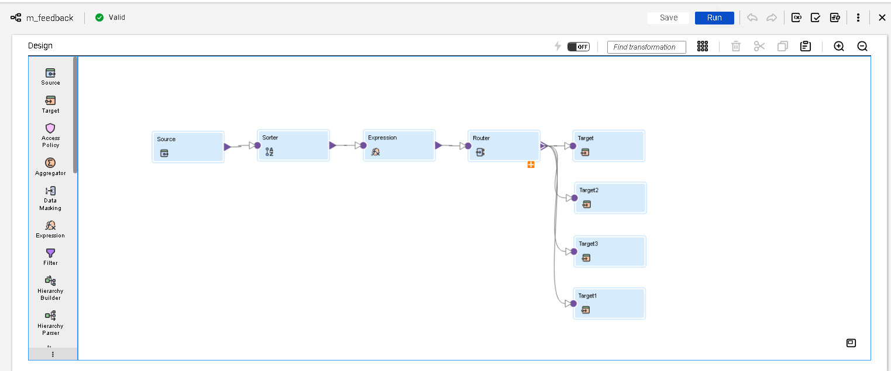
Reusable cleansing mapping (m_feedback)
DATA INTEGRATION
Performs reusable data cleansing, standardization, validation and transformation for common hospitality source data.

Slide 11
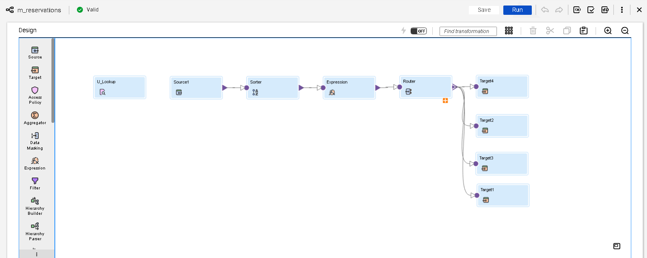
Reservation processing mapping (m_reservations)
DATA INTEGRATION
Applies business rules, validates records and prepares clean reservation data for Snowflake.

Slide 12
The project in numbers
RESULTS
7,160
source records across hospitality datasets
99.96% of records approved by IDMC. AWS S3 provides the source and exception-file location; IDMC validates and routes records before Snowflake processing.
7
Hospitality datasets
Guests, Hotels, Rooms, Reservations, Billing, Feedback and Booking Events
7,157
Valid records
Records approved by IDMC for downstream Snowflake processing
4 + 4
Facts + dimensions
Hospitality star schema: four fact tables and four dimension tables
20
Quality findings
Nulls, duplicates, invalid records and warning cases tracked separately

Slide 13
Bronze – Silver – Gold: medallion architecture
DATA MODELLING
Each layer has a distinct responsibility in progressing from source-aligned data to business-ready information.
01 BRONZE
LAND & TRACE
02 SILVER
CLEAN & CONFORM
03 GOLD
MODEL & SERVE
Source-aligned records
File and batch metadata
Reconciliation and traceability
Data types and standard formats
Duplicate and relationship checks
Historical change tracking
Fact and dimension tables
Business marts and KPI calculations
Secure analytical consumption
Outcome: controlled data refinement, improved trust and a consistent foundation for reporting.

Slide 14
SCD Type 2: historical change tracking
DATA MODELLING
SCD Type 2 preserves previous dimension values when tracked business attributes change.
1
2
3
4
MATCH
COMPARE
EXPIRE
INSERT
Find the existing dimension record using its business key.
Compare incoming attributes with the current record by update timestamp.
Close the previous version by setting IS_CURRENT = FALSE.
Insert a new version with updated attributes and IS_CURRENT = TRUE.
KEY COLUMNS
IS_CURRENT
SOURCE_UPDATED_TIMESTAMP
BUSINESS VALUE
Supports as-of reporting, historical comparisons and auditability.

Slide 15
Historical reservation processing with SCD Type 2
DATA MODELLING
LOAD AND COMPARE
VERSION AND RETAIN
Initial reservation data is loaded into the Bronze layer.
New reservations are inserted.
1
4
Silver processing identifies new and existing reservation records.
Changed reservations cause the previous version to be expired.
2
5
The stored procedure compares incoming reservation values with the current version.
A new version is inserted with the updated values.
3
6
Result: effective dates and the current-record indicator maintain the full reservation history.

Slide 16
Hospitality Galaxy Schema (dimensional model)
DATA MODELLING
DIM_GUEST
DIM_HOTEL
DIM_ROOM
DIM_DATE
guest_key (PK)
guest_id
first_name · last_name
email · phone
country
loyalty_tier
created_date
hotel_key (PK)
hotel_id
hotel_name
city · state · country
hotel_type
star_rating
room_key (PK)
room_id
room_type
capacity
bed_type
base_price
date_key (PK)
full_date
day · day_name
week · month · month_name
quarter · year
is_weekend
Joined on surrogate keys
SURROGATE-KEY JOINS · CONFORMED DIMENSIONS
Joined on surrogate keys
FACT_RESERVATION
FACT_BILLING_TRANSACTION
FACT_GUEST_FEEDBACK
FACT_BOOKING_EVENT
reservation_key (PK)
FK: guest · hotel · room · date
reservation_id
booking_date
check_in_date · check_out_date
booking_channel
reservation_status
total_amount
billing_key (PK)
FK: guest · hotel · date
transaction_id
transaction_type
amount · currency
payment_method
transaction_status
feedback_key (PK)
FK: guest · hotel · room · date
feedback_id
rating
feedback_text
sentiment_score
event_key (PK)
FK: guest · hotel · date
event_id
event_type
event_timestamp
channel
event_status
Aggregated into business marts
AGGREGATED INTO BUSINESS MARTS
Aggregated into business marts
MART_OCCUPANCY_REVENUE
MART_BOOKING_CHANNEL
MART_GUEST_EXPERIENCE
MART_BOOKING_CONVERSION
Hotel / date-wise occupancy
Revenue (ADR, RevPAR, Total)
Occupancy rate trends
Bookings and revenue by channel
Channel performance trends
Conversion contribution
Guest ratings & sentiment
Hotel / room-wise feedback
Satisfaction trends
Event funnel (search → view → book)
Conversion rate by channel
Drop-off analysis
Dimension (lookup)
Fact (measures / events)
Analytical mart

Slide 17
Executive overview: revenue, occupancy, sentiment
ANALYTICS & INSIGHTS
Headline KPIs for all hotels and regions, 01 Jan 2024 – 31 Dec 2025.
ROOM REVENUE
₹4.89 Cr
Total for selected period
ADR
₹5,811.20
Average daily rate
GUEST RATING
4.14 / 5
499 responses
ROOM NIGHTS SOLD
8,418
Occupied room nights
RESERVATIONS
2,195
Booking-channel mart
BOOKING ADR
₹5,821.13
Channel-mart view of rate
RECOMMENDATION RATE
80.6%
Would recommend the hotel
PEAK REVENUE MONTH
Mar 2025 at ₹29.94 L
DATA NOTE
Occupancy of 0.1% uses a very large available room-night base (7,383,100); definition flagged for review.
Source: Streamlit app on Snowflake Gold layer. All hotels, all regions.

Slide 18
Revenue performance and booking channels
ANALYTICS & INSIGHTS
Occupancy & revenue
Room-night utilization, hotel performance and revenue trends
Booking channels
Channel contribution, rate-plan mix and booking behaviour
ROOM NIGHTS SOLD
8,418
Occupied room nights
ROOM REVENUE
₹4.89 Cr
₹48,918,721.85
RESERVATIONS
2,195
Across selected channels
ROOM REVENUE
₹5.06 Cr
₹50,636,031.63
ADR
₹5,811.20
Revenue ÷ room nights
ROOM NIGHTS
8,699
Booked room nights
ADR
₹5,821.13
Revenue ÷ room nights
Corporate leads with 21% of room revenue across the five booking channels (Corporate, Mobile App, OTA, Travel Agent, Website). Channel figures come from the booking-channel mart, so totals differ from the occupancy view.
Source: Streamlit app on Snowflake Gold layer. All hotels, all regions, 01 Jan 2024 – 31 Dec 2025.

Slide 19
Guest experience: ratings and recommendation
ANALYTICS & INSIGHTS
Guest feedback, service ratings and recommendation signals.
FEEDBACK RECORDS
499
Responses in period
OVERALL RATING
4.14 / 5
Weighted by responses
Average rating (1–5 scale)
SERVICE RATING
4.05 / 5
Staff & service
RECOMMENDATION
80.6%
Would recommend
Also in the app: monthly rating trends (overall and service), hotel ranking and a rating heatmap.
Source: Streamlit app on Snowflake Gold layer. All hotels, all regions, 01 Jan 2024 – 31 Dec 2025.

Slide 20
Booking conversion: search to confirmation
ANALYTICS & INSIGHTS
The digital booking journey, all channels.
SEARCH SESSIONS
186
Top of funnel
BOOKING STARTED
170
Began checkout
CONFIRMED SESSIONS
182
Completed bookings
SEARCH-TO-BOOKING
97.8%
Confirmed ÷ searches
Share of searches reaching each stage (%)
Stage retention
Stage | % of searches | % of previous
Search | 100.00 | 100.00
Room view | 94.10 | 94.10
Rate quote | 99.50 | 105.70
Booking started | 91.40 | 91.90
Booking confirmed | 97.80 | 107.10
Source: Streamlit app on Snowflake Gold layer. All channels, all hotels, 01 Jan 2024 – 31 Dec 2025.

Slide 21
Reservation risk: rule-based scoring
ANALYTICS & INSIGHTS
Transparent, rule-based scores — not a trained predictive model; rules can be adjusted for what-if scenarios.
Risk distribution
LOW RISK
451
20.5% of reservations
MEDIUM RISK
1,388
63.2% of reservations
HIGH RISK
356
16.2% of reservations
Hotels with the most high-risk reservations
Top four, ranked by high-risk count
1
Aurelia Chennai Residency
2
Grand Vista Chennai Resort
3
Blue Orchid Hyderabad Resort
2,195 reservations scored
4
Aurelia Hyderabad Residency
Source: Streamlit app on Snowflake Gold layer. All hotels, all regions, 01 Jan 2024 – 31 Dec 2025.

Slide 22
Dashboard findings and follow-up actions
ANALYTICS & INSIGHTS
WHAT THE DATA SHOWS
TO VALIDATE BEFORE GO-LIVE
Corporate leads channel revenue
21% of room revenue; ADR is about ₹5.8K on every page.
Occupancy definition
Occupancy shows 0.1% (8,418 of 7,383,100 room nights). Confirm the available-room-night base.
1
Guest satisfaction is strong
4.14 / 5 overall across 499 responses; 80.6% would recommend.
2
Funnel event sequence
Confirmed sessions (182) exceed booking started (170), so some stage retention is above 100%. Confirm event ordering.
Digital conversion is efficient
186 search sessions with a 97.8% search-to-booking rate.
3
Cross-page reconciliation
Occupancy page shows ₹4.89 Cr and 8,418 nights; Booking Channels shows ₹5.06 Cr and 8,699 nights. Align mart definitions.
Most reservations carry medium risk
63.2% medium and 16.2% high (356 reservations) of 2,195.
4

Slide 23
Role-based access control and data security
SECURITY
Access is granted according to business responsibilities, with sensitive data protected through masking.
ROLE HIERARCHY
1
HOTEL_REVENUE_ANALYST_ROLE
Revenue, channel and billing analytics
2
GUEST_EXPERIENCE_ROLE
Guest feedback and satisfaction
3
HOTEL_MANAGER_ROLE
Inherits revenue analyst and guest experience access
4
HOTEL_DATA_ENGINEER_ROLE
Builds and operates the pipeline
SECURITY CONTROLS AND VALIDATION APPROACH
Secure views
Expose business information through secure views.
Masking policies
Apply masking policies to sensitive fields.
Role privileges
Grant database, schema and warehouse privileges by role.
Access testing
Switch roles with USE ROLE, test permitted and denied access, and verify restrictions work as intended.

Slide 24
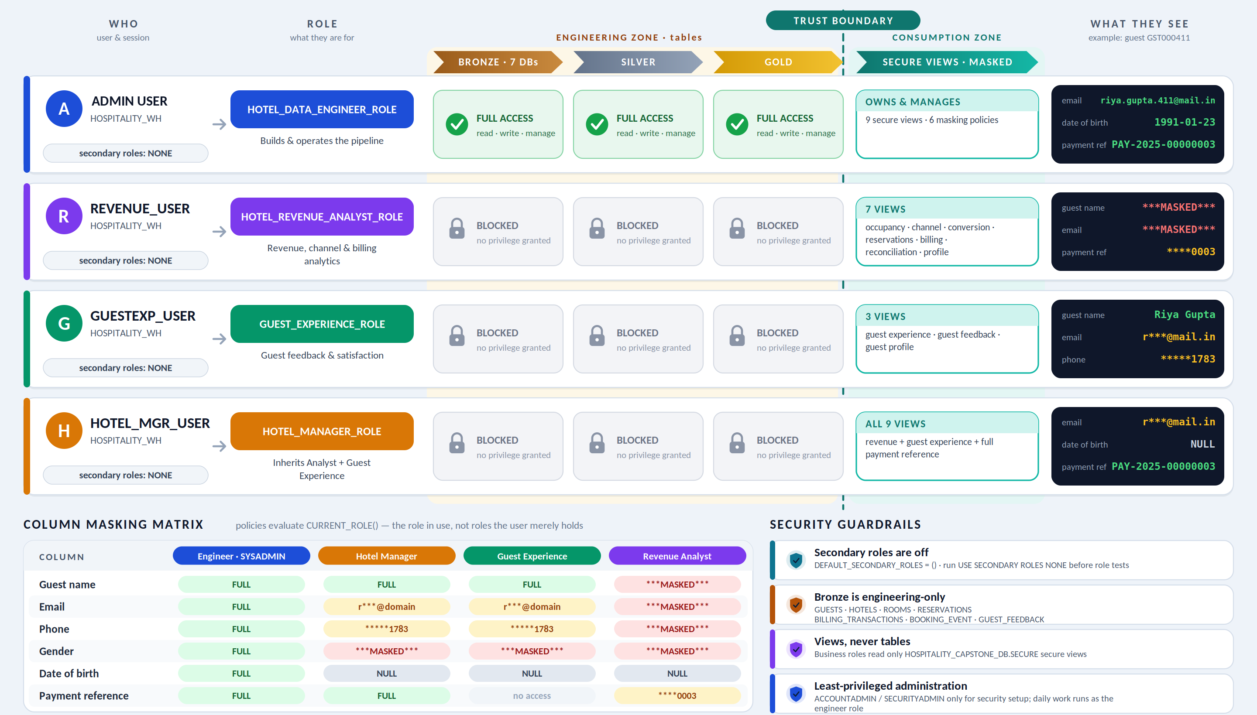
Role-based access control and data security
SECURITY

Slide 25
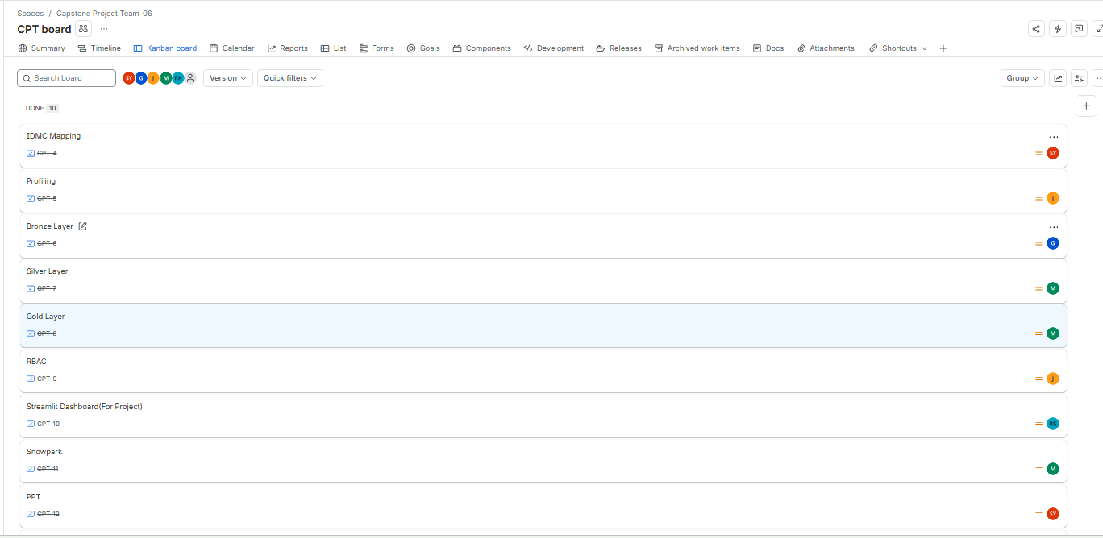
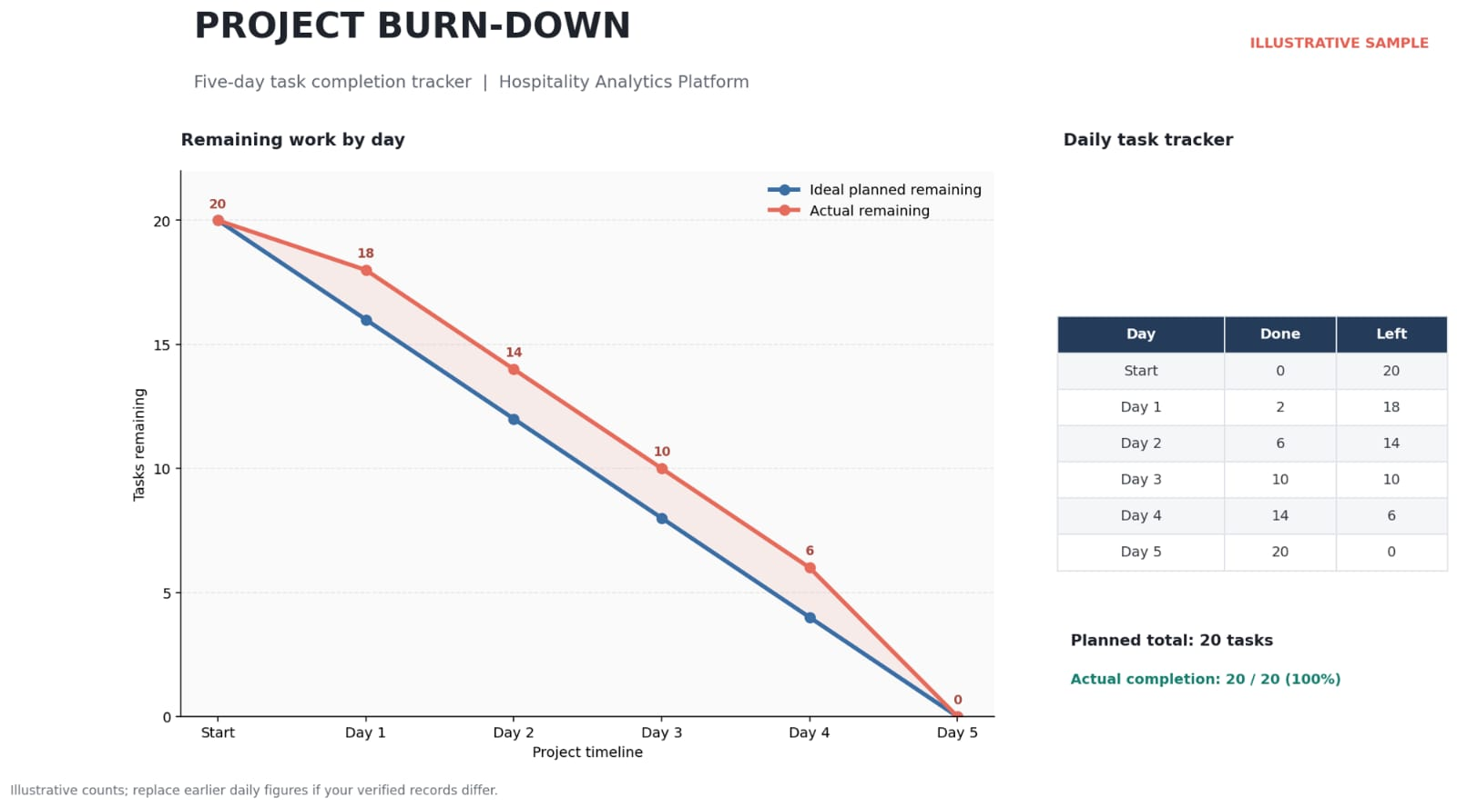
Five-day delivery plan and burn-down
VALIDATION & DELIVERY

Slide 26
Snowflake Cortex: AI opportunity
Potential enhancement: apply AI-powered functions to guest feedback and natural-language analytics.
1
2
3
Sentiment analysis
Feedback summarization
Natural-language analytics
Classify guest comments to understand positive, neutral and negative sentiment.
Summarize recurring themes from guest comments and service feedback.
Allow business users to explore selected metrics using natural-language questions.
STARTING POINT
499 guest feedback records and the existing Guest Experience page provide a ready base for sentiment and summary use cases.

Slide 27
Guest Feedback Analysis & Recovery Recommendation Engine
UNIQUE SELLING POINT 1
An AI-powered engine that turns guest ratings and comments into insight on satisfaction and service problems.
1
2
3
Business objective
Data foundation
Intelligence layer
Helps management understand guest satisfaction, spot service problems and see where improvement is needed.
Uses guest ratings, feedback comments and reservation information stored in Snowflake.
Performs guest sentiment analysis, issue classification and recovery prioritization.
EXPLAINABLE BY DESIGN
Recommendations come from predefined analytical rules, so they are consistent and easy to explain.

Slide 28
Recovery priorities and the Guest Recovery Assistant
UNIQUE SELLING POINT 1
Dissatisfied guests are prioritized and matched with suggested recovery actions in an interactive dashboard.
1
2
3
Recovery priority
Suggested actions
Guest Recovery Assistant
Feedback ratings and identified issues assign each case a High, Medium or Low recovery priority.
Contact dissatisfied guests, arrange service follow-ups, address room complaints or improve housekeeping.
Streamlit dashboard feature to investigate negative feedback, review priority cases and see recommended actions.
OUTCOME
Hotels respond faster to complaints, improve service quality and support better guest satisfaction and retention.

Slide 29
Pricing Intelligence & Revenue Opportunity Engine
UNIQUE SELLING POINT 2
The ninth module of the Hospitality Analytics Platform, built to uncover pricing anomalies and revenue upside.
1
2
3
Business objective
Technology stack
Data integration
Helps hotel management identify unusual room pricing, optimize revenue strategies and discover revenue improvement opportunities.
Snowflake SQL, Snowpark Python, Streamlit and Altair for data processing, analytics and interactive visualization.
Uses existing Gold-layer reservation, room, hotel and billing datasets.
NO NEW PIPELINES
The engine runs entirely on existing Gold-layer data, so no additional ETL pipelines are required.

Slide 30
How the engine detects pricing anomalies
UNIQUE SELLING POINT 2
Reservation rates are benchmarked against comparable bookings to flag unusual pricing.
1
2
3
Rate benchmarking
Peer-based analysis
Anomaly detection
Compares actual reservation nightly rates against relevant historical booking benchmarks.
Groups comparable reservations by hotel, room type and season for meaningful pricing comparisons.
Applies rule-based and statistical logic to identify unusually low or high reservation rates.
OUTCOME
Management can act on flagged rates to refine pricing strategy and capture revenue improvement opportunities.

Slide 31
Thank you
Questions and discussion
Suggestions are always welcome.

